Slide 1
Hayat حياة
A Quantum-Computing based
Kidney Transplantation Matching Software

Slide 2

Problem - Kidney Transplantation
Every year in the UAE:
More than 60,000 patients need a kidney transplant
Less than 20% receive it
“how to make each precious kidney go to the most appropriate patient?”

Slide 3

Problem - Kidney Transplantation
Blood type
Kidney size
Age
Weight
Distance

Slide 4

Solution

Slide 5
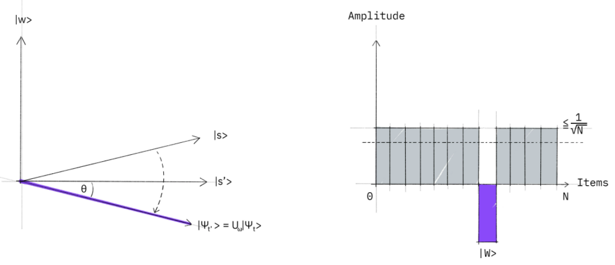


2. Strategies Explored:
QUBO
(Quadratic Unconstrained Binary Optimization)
Grover’s Adaptive Search
Notes:
Swaraj talks about the efficiency

Slide 6




3. System Architecture
MongoDB DATABASE
Flask Connection
Backend SERVER
QPU
Responsive UI
Notes:
(Not going to mention the part)

Slide 7
4. Demo
https://drive.google.com/file/d/1xS1yKROUQTIXy-u7Z_R1qBmPwNbecuuH/view?usp=sharing

Slide 8


5. Future
Faster
Lower time complexity
Scalable
Can handle more parameters
Notes:
Currently not available - but if resolved - operate with much lower time complexity compared to the classical approaches
With Hayat, we can handle more parameters to get better matchings
Time-urgent issue: 4 hours for transportation - fast calculation is necessary/

Slide 9
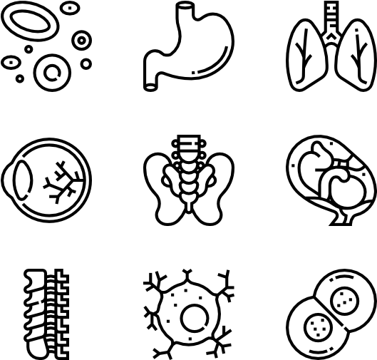

5. Future
Extensible
Applicable to different organ transplants
Optimized
Medication resource allocation
Notes:
Other organs-future

Slide 10


6. Impact
Increases Life Expectancy
Health & happiness
Accessibility
More equitable distribution

Slide 12
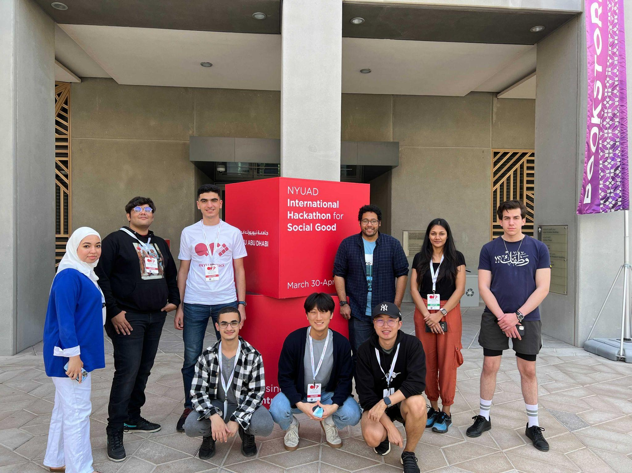
THANK YOU!
Mentors:
Scott Oshiro 213syo@gmail.com
Stanford University
Aishwarya Sahai asahai@umass.edu
University of Massachusetts
Hackers:
Maryam Almetnawy 202010914@ajmanuni.ac.ae
Ajman University - UAE
Runyao Fan rf1888@nyu.edu
NYUAD- UAE
Ahmad Fraij af3954@nyu.edu
NYUAD - UAE
Ouassim Hamdani o_hamdani@estin.dz
ESTIN - Algeria
Minwu Kim mwk300@nyu.edu
NYUAD - UAE
Swaraj Purohit swarajpurohit@gmail.com
Vishwanath Karad Mit World Peace University - India
Mohammad Issam mo.qasrawi00@gmail.com
Applied science private university - Jordan
NYUAD-2022/team5 at main · NYUADQCHack2022/NYUAD-2022 · GitHub

